Slide 1
MUSTANG INDUSTRIAL SPECIAL USE PERMIT
WASHOE COUNTY BOARD OF ADJUSTMENT
November 4, 2021

Slide 2
Project request
A Special Use Permit to allow for the establishment of a warehousing use within the Industrial (I) regulatory zone; to allow for Major Grading per the standards of Section 110.438.35 of the Washoe County Development Code; and to allow for modification of standards to permit 2:1 graded slopes, allow finished grading to vary from slope by more than 10 feet, and to reduce exterior landscaping.

Slide 3
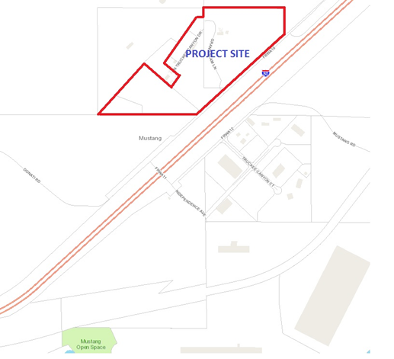
Project location
North side of interstate 80 at the mustang exit

Slide 4
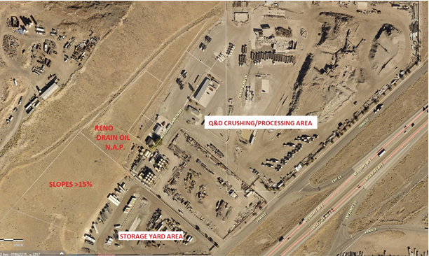
Aerial view
Industrial materials processing occurring now

Slide 5
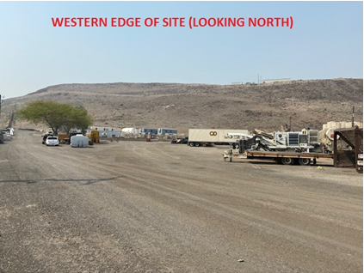
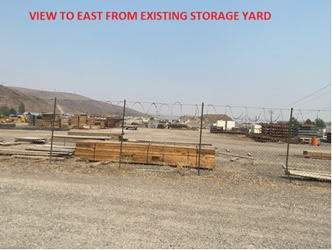
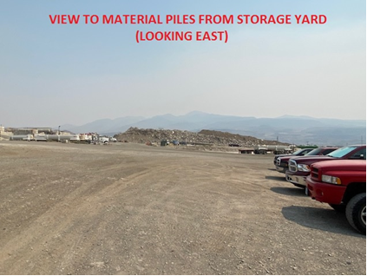
EXISTING CONDITIONS
Current q&d operations

Slide 6
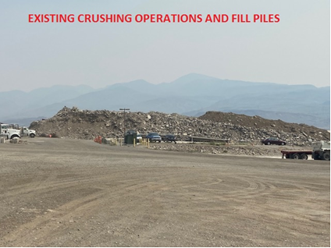
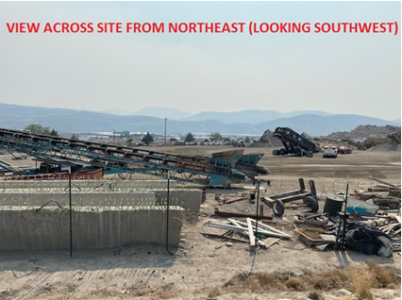
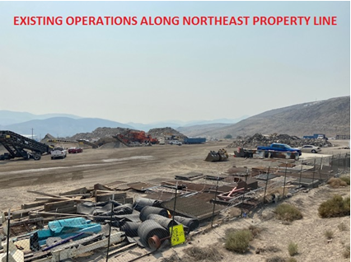
EXISTING CONDITIONS
Current q&d operations

Slide 7
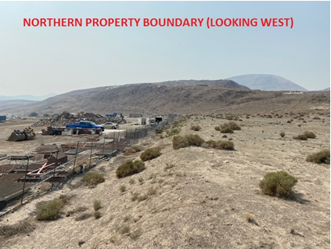
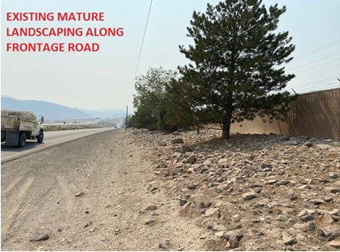
EXISTING CONDITIONS
Current q&d operations

Slide 8
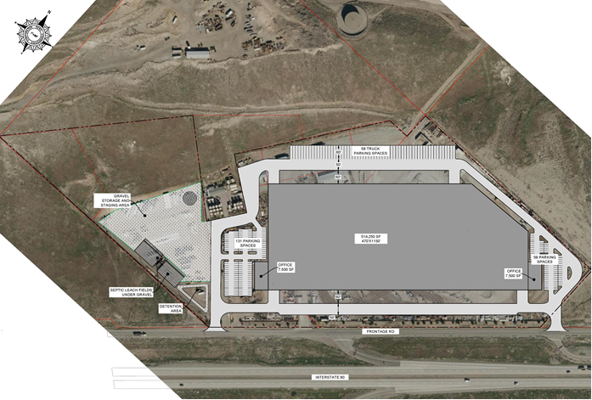
Site plan
529,250 sq.ft. warehouse/distribution use

Slide 9
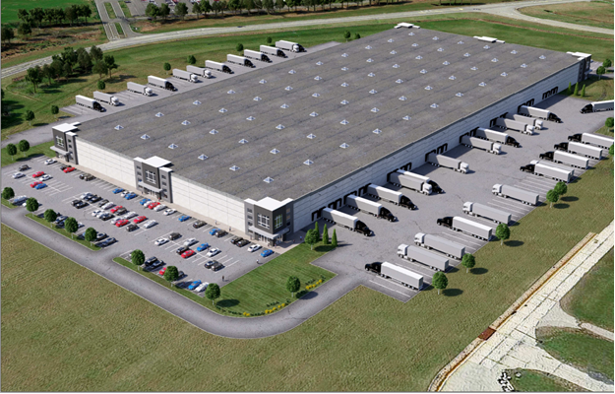
Building elevation

Slide 10
project considerations
Warehouse/Distribution use is consistent with other industrial uses in the area.
New project will significantly improve site aesthetics.
Grading is consistent with a project/building of this size.
10’ slope deviation is a result of imported materials.
Grading essentially returns site to its previous natural state.
2:1 slopes (in select areas) ensure less disturbance.
Landscape deviations only proposed in areas not visible to the public.

Slide 11
project considerations
Site disturbance is 85% or roughly what exists now.
Mature landscaping is protected/preserved and forms an “instant” screen from I-80.
Easements to adjoining properties are perpetuated.
Outdoor storage area will be fully screened.
No variances are requested.

Slide 12
Mike Railey
Christy Corporation
Rex Massey
Sparks Mustang, LLC

